Slide 1

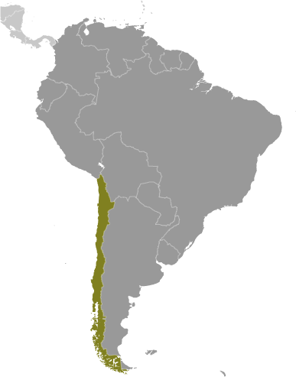

Chile
Supply Side Growth
Richard Luong
Sureshmi Wijewardena
Asmita Sangepag
Garni Gharekhanian
Pavan Bedadala

Slide 2
Chile – A Growth Star in South America
What are the sources of or reasons for Chile’s strong growth performance?
What are key issues that Chile faces as it attempts to continue its record of strong growth?
How much growth will Chile achieve in the next decade?

Slide 3
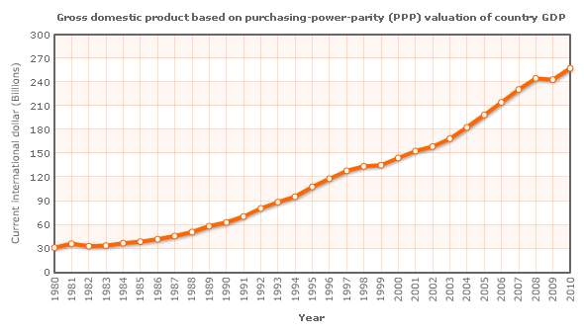
Chile Overview
Avg 4% growth per year since 1999
High Level of Foreign Trade
Strong Financial Institutions (stable, highly liquid)
  High level of credit rating
Highest Nominal GDP per capita (Latin America)
GDP (PPP): $260 billion Rank 44
Notes:
Leads Latin America in human development, competitiveness, income per capita, globalization, economic freedom, and low perception of corruption

Slide 4
Chile Overview
Foreign Trade & Investment
  Over last 4 yrs, foreign Investment inflows x4 to $15 billion in 2010
  World Bank ease of doing business 49th in the world
    Better, simpler regulations
    Strong protection of property rights
  Trade Agreements
    2004 - Free Trade Agreement with US
    2010 - First South American country in OECD (Org for Econ Cooperation and Dev)
Notes:
Claims more (57) bilateral or regional trade agreement than any other country European Union, Mercosur, China, India, South Korea, and Mexico

Slide 5
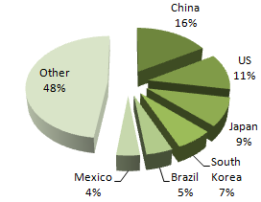
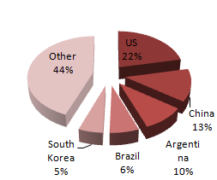
Chile Exports & Imports
Exports (1/4th of GDP)
  World's largest copper producer (30% of export revenues)
  Fruit, Fish products, paper and pulp, chemicals, wine
Imports
  Petroleum
  Chemicals
  Electrical and telecommunications equipment, industrial machinery, natural gas

Slide 6
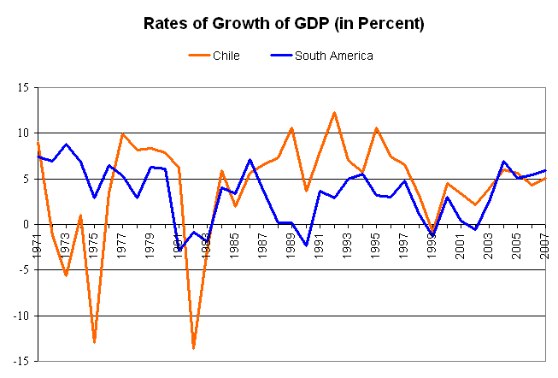
Economic Growth
Source: Wikipedia

Slide 7
Augusto Pinochet
High Inflation curbed through payments of debt, pegging peso to USD
Privatization of pension system led to higher domestic savings
Privatization of state-owned companies led to greater labor productivity
Economic liberalization resulted in increased lending, foreign investment, and eliminated protectionism
Notes:
‘resideded: 73 – 90
In 1973, Chile had experienced chronic inflation that was rising into hundreds of percent, the country had no foreign reserves, and GDP was falling
Micracle of Chile – 80’s through ‘00’s
Copper Mines, other state-run industries
http://en.wikipedia.org/wiki/Augusto_Pinochet

Slide 8
Sources of Growth
Government Policies
    Low corruption, ease of doing business
Human Capital
    Reducing infant mortality -> higher life expectancy
Institutions
    Geography, free trade, foreign direct investment
Technology
    Production process improvements
Notes:
Corruption: 2010 Index, #21 (US: 22)
EoDB: 43 in 2010; 4th in Latin America
Reduction in infant mortality rate 82% from ‘70 to ‘92
Increasing life expectancy rate
http://www.transparency.org/policy_research/surveys_indices/cpi/2010/results
http://en.wikipedia.org/wiki/Miracle_of_Chile

Slide 9
Solow Growth Model
Y’ss
Yss
Kss
K’ss
Notes:
K=K+I-D
I=S
S=bY
Y=AK^aL^(1-a)
Privatizing Pension -> Higher Domestic Savings, Incr. I
Incr in L: life exp, health;
All others incr A -> Incr Y

Slide 10
Issues Regarding Growth
Excessive dependence on copper exports. This leads to economic growth being dependent on world copper prices.
As Chile is a relatively small country, its growth is dependent on external conditions. For instance, growth slowed significantly due to the Asian financial crisis of 1997, from 7.3pc (1984-1997 average) to 3pc.
Highly dependent on petroleum imports, making it vulnerable to oil price spikes.

Slide 11
Room for Improvement
Increase provision of infrastructure
Improve educational quality
Further diversify the economy and export sector in particular

Slide 12
Forecasting GDP
Mathematical model and Cobb-Douglas Production function used.
Y(t)=A .K^{0.3} . L^{0.6}
Collect historical data (* Source: databank.worldbank.org) 1981-2010
- Population
  Capital
  Labor Participation Rate
  Unemployment Rate
  GDP
Estimate population, labor, TFP and Investment rate for years 2011-2020
Using all these factors calculate GDP for years 2011-2020 with the production function
Assumptions made:
1) d=2.5%, d=rate of depreciation & a=0.33
2) no natural disasters or recession occurs in the decade 2011-2020
3) The GDP values in terms of 2000 US dollar

Slide 13
Forecasting Labor
    Population growth rate is assumed to be declining and future growth rate is predicted in a linear fashion
    With the determined population growth rate, future population for next decade is calculated.
    Labor Participation Rate and Unemployment Rate are assumed to be constant at an average rate.
    Compute Labor by applying Labor Participation Rate and Unemployment Rate on Population
    Labor = Population*(Labor Participation Rate/100)*(1-Unemployment rate/100)

Slide 14
Population Trends

Slide 15
Labor Trends
Historical
Predicted

Slide 16
Forecast TFP & Investment Rate
TFP(A) is predicted using the Cobb-Douglas function:
a=0.33
TFP(A) =GDP
K^{0.33} * L^{0.66}
Investment Rate: in a perfect economy I=S
But we compute using
K(t+1)=GDP(t)*S –d*K(t)
Assuming d=2.5%
Using excel forecast function we predict TFP and I in a linear fashion.

Slide 17
TFP Trends

Slide 18
Forecast Capital
Forecast Capital by applying following function,
K(t) = K(t-1) – dK(t-1) + sY(t-1)
K(t-1): Capital of previous year
d: Depreciation Rate 2.5%
s: Investment Rate
Y(t-1): GDP/Output of previous year
Above values obtained from historical data.

Slide 19
Capital Trends

Slide 20
Forecasting GDP
Estimate GDP from Labor, Capital and TFP using Cobb Douglas function,
Y = A * K ^ 0.33 * L ^ 0.66
Y: Output/GDP
K: Capital
L: Labor
A: Solow Residual (TFP)

Slide 21
GDP Trends

Slide 22
Questions?

Slide 23
Appendices

Slide 24
Forecast Labor

Slide 25
Forecast TFP

Slide 26
Forecast GDP

Slide 27
Historical Data Finds
We see that in the past decade
Population: growth rate has been decreasing
Labor: growth almost constant
Capital: increasing except in the recession of 2008-2009 and 1998-2000
TFP: almost steady but shot up in 2008-2009
GDP: steady rise with the exception of 2000 and also a surprising rise during recession of 2008-09

Slide 28
Forecasting GDP
Mathematical model used based on Production function
Collect historical data (* Source: databank.worldbank.org)
- Population
  Capital
  Labor Participation Rate
  Unemployment Rate
  GDP
Estimate population, labor, TFP and Investment rate for years 2011-2020
Using all these factors calculate GDP for years 2011-2020 with the production function
Assumptions made:
1) d=2.5%
2) no natural disasters or recession occurs in the decade 2011-2020
3) The GDP values in terms of 2000 US dollar

Slide 29
Historical Data Finds
We see that in the past decade
Population: growth rate has been decreasing
Labor: growth almost constant
Capital: increasing except in the recession of 2008-2009 and 1998-2000
TFP: almost steady but shot up in 2008-2009
GDP: steady rise with the exception of 2000 and also a surprising rise during recession of 2008-09

Slide 30
Historical Labor Trend

Slide 31
Historical Population Trend

Slide 32
Historical TFP Trend

Slide 33
Historical Capital Trend

Slide 34
Historical GDP Trend

Slide 35
Forecasting Labor
    Population growth rate is assumed to be declining and future growth rate is predicted in a linear fashion
    With the determined population growth rate, future population for next decade is calculated.
    Labor Participation Rate and Unemployment Rate are assumed to be constant at an average rate.
    Compute Labor by applying Labor Participation Rate and Unemployment Rate on Population
    Labor = Population*(Labor Participation Rate/100)*(1-Unemployment rate/100)

Slide 36
Forecast Population

Slide 37
Forecast Labor

Slide 38
Forecast Capital
Forecast Capital by applying following function,
K(t) = K(t-1) – dK(t-1) + sY(t-1)
K(t-1): Capital of previous year
d: Depreciation Rate
s: Investment Rate
Y(t-1): GDP/Output of previous year
Above values obtained from historical data.

Slide 39
Forecast Capital

Slide 40
Forecast TFP & Investment Rate
TFP(A) is predicted using the Cobb-Douglas function:
a=0.3
TFP(A) =GDP
L^0.3 * K^0.6
Investment Rate: in a perfect economy I=S
But we compute using
K(t+1)=GDP(t)*S –d*K(t)
Assuming d=2.5%
Using excel forecast function we predict TFP and I in a linear fashion.

Slide 41
Forecast TFP

Slide 42
Forecasting GDP
Estimate GDP from Labor, Capital and TFP using Cobb Douglas function,
Y = A * K ^ 0.33 * L ^ 0.66
Y: Output/GDP
K: Capital
L: Labor
A: Solow Residual (TFP)

Slide 43
Forecast GDP

